Slide 1

Database Systems:
Design, Implementation, and Management
Ninth Edition
Chapter 15
Database Administration and Security

Slide 2
Objectives
In this chapter, students will learn:
That data are a valuable business asset requiring careful management
How a database plays a critical role in an organization
That the introduction of a DBMS has technological, managerial, and cultural consequences for an organization
Database Systems, 9th Edition

Slide 3
Objectives (cont’d.)
What the database administrator’s managerial and technical roles are
About data security, database security, and the information security framework
About several database administration tools and strategies
How various database administration technical tasks are performed with Oracle
Database Systems, 9th Edition

Slide 4
Data as a Corporate Asset
Data:
  Valuable asset that requires careful management
  Valuable resource that translates into information
Accurate, timely information triggers actions that enhance company’s position and generate wealth
Dirty data
  Data that suffer from inaccuracies and inconsistencies
  Threat to organizations
Database Systems, 9th Edition

Slide 5
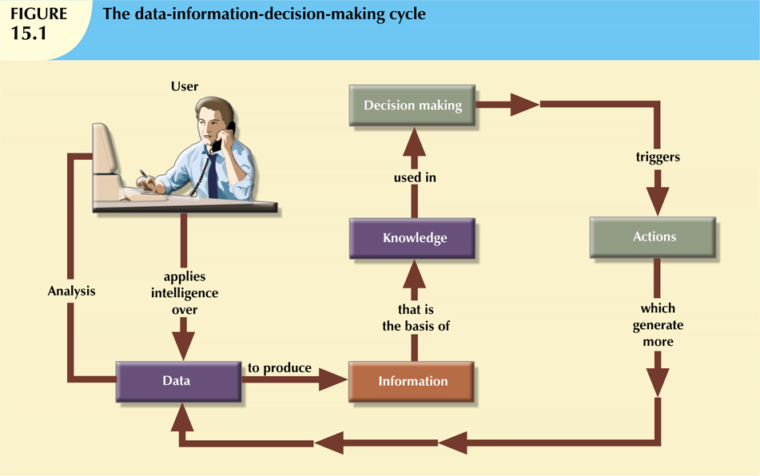
Database Systems, 9th Edition

Slide 6
Data as a Corporate Asset (cont’d.)
Data quality
  Comprehensive approach to ensuring the accuracy, validity, and timeliness of the data
Data profiling software
  Consists of programs that gather statistics and analyze existing data sources
Master data management (MDM) software
  Helps prevent dirty data by coordinating common data across multiple systems.
Database Systems, 9th Edition

Slide 7
The Need for and Role of Databases in an Organization
Database’s predominant role is to support managerial decision making at all levels
DBMS facilitates:
  Interpretation and presentation of data
  Distribution of data and information
  Preservation and monitoring of data
  Control over data duplication and use
Three levels to organization management:
  Top, middle, operational
Database Systems, 9th Edition

Slide 8
Introduction of a Database:
Special Considerations
Introduction of a DBMS is likely to have a profound impact
  Might be positive or negative, depending on how it is administered
Three aspects to DBMS introduction:
  Technological
  Managerial
  Cultural
One role of DBA department is to educate end users about system uses and benefits
Database Systems, 9th Edition

Slide 9
The Evolution of the Database Administration Function
Data administration has its roots in the old, decentralized world of the file system
Advent of DBMS produced new level of data management sophistication
  DP department evolved into information systems (IS) department
Data management became increasingly complex
  Development of database administrator (DBA) function
Database Systems, 9th Edition

Slide 10
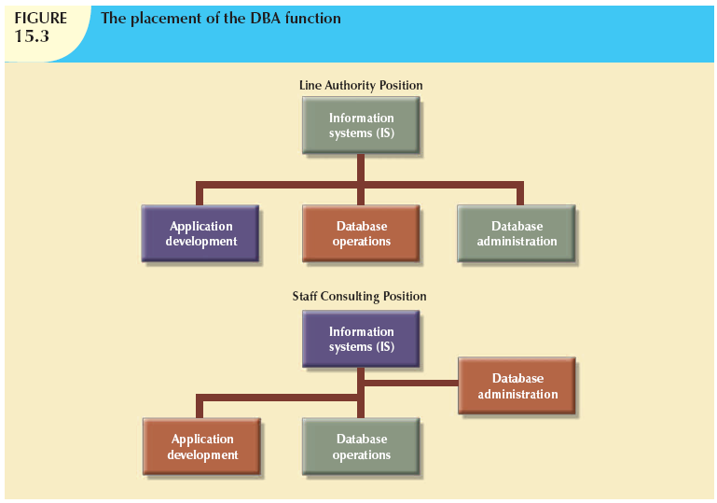
Database Systems, 9th Edition

Slide 11
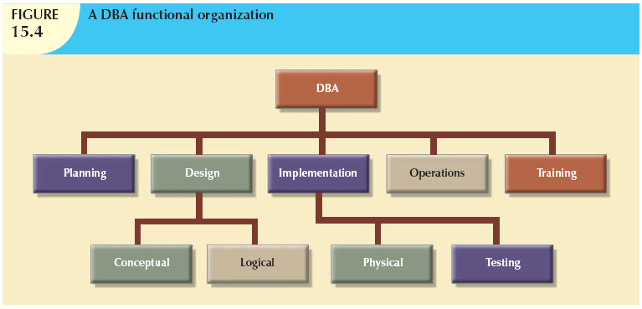
Database Systems, 9th Edition

Slide 12
The Database Environment’s
Human Component
Even most carefully crafted database system cannot operate without human component
Effective data administration requires both technical and managerial skills
DA must set data administration goals
DBA is focal point for data/user interaction
Need for diverse mix of skills
Database Systems, 9th Edition

Slide 13
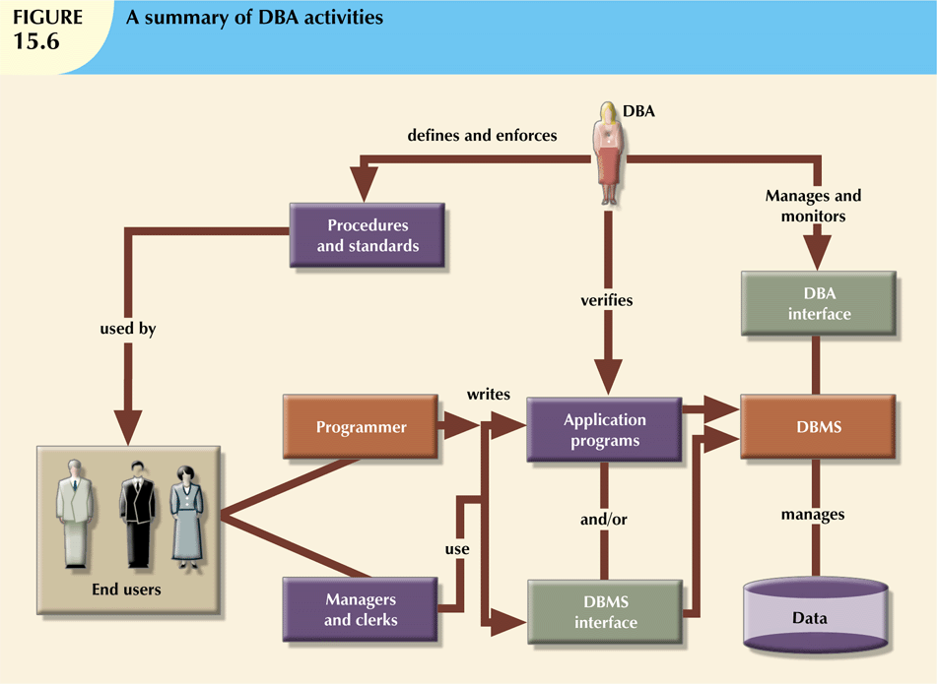
Database Systems, 9th Edition

Slide 14
The DBA’s Managerial Role
DBA responsible for:
  Coordinating, monitoring, allocating resources
    Resources include people and data
  Defining goals and formulating strategic plans
Interacts with end user by providing data and information
Enforces policies, standards, procedures
Database Systems, 9th Edition

Slide 15
The DBA’s Managerial Role (cont’d.)
Manages security, privacy, integrity
Ensures data can be fully recovered
  In large organizations, database security officer (DSO) responsible for disaster management
Ensures data is distributed appropriately
  Makes it easy for authorized end users to access the database
Database Systems, 9th Edition

Slide 16
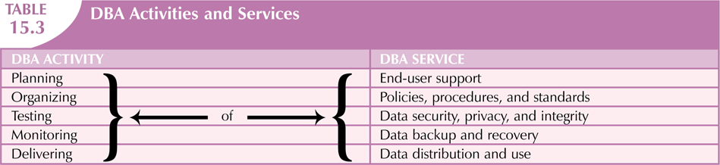
Database Systems, 9th Edition

Slide 17
The DBA’s Technical Role
Evaluates, selects, and installs DBMS and related utilities
Designs and implements databases and applications
Tests and evaluates databases and applications
Database Systems, 9th Edition

Slide 18
The DBA’s Technical Role (cont’d.)
Operates DBMS, utilities, and applications
Trains and supports users
Maintains DBMS, utilities, and applications
Database Systems, 9th Edition

Slide 19
Security
Securing data entails securing overall information system architecture
Confidentiality: data protected against unauthorized access
Integrity: keep data consistent and free of errors or anomalies
Availability: accessibility of data by authorized users for authorized purposes
Database Systems, 9th Edition

Slide 20
Security Policies
Database security officer secures the system and the data
  Works with the database administrator
Security policy: collection of standards, policies, procedures to guarantee security
  Ensures auditing and compliance
Security audit process identifies security vulnerabilities
  Identifies measures to protect the system
Database Systems, 9th Edition

Slide 21
Security Vulnerabilities
Security vulnerability: weakness in a system component
  Could allow unauthorized access or cause service disruptions
Security threat: imminent security violation
  Could occur at any time
Security breach yields a database whose integrity is either:
  Preserved
  Corrupted
Database Systems, 9th Edition

Slide 22
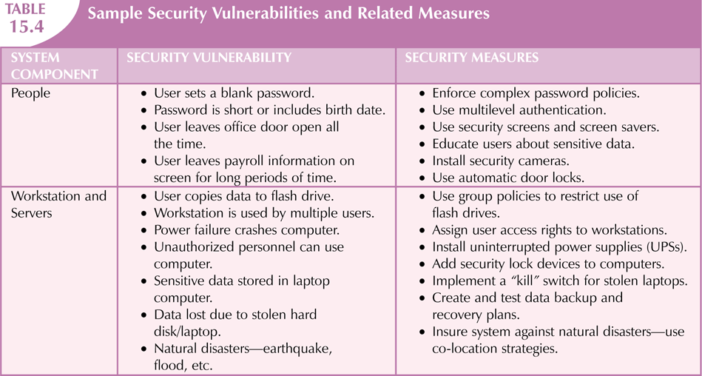
Database Systems, 9th Edition

Slide 23
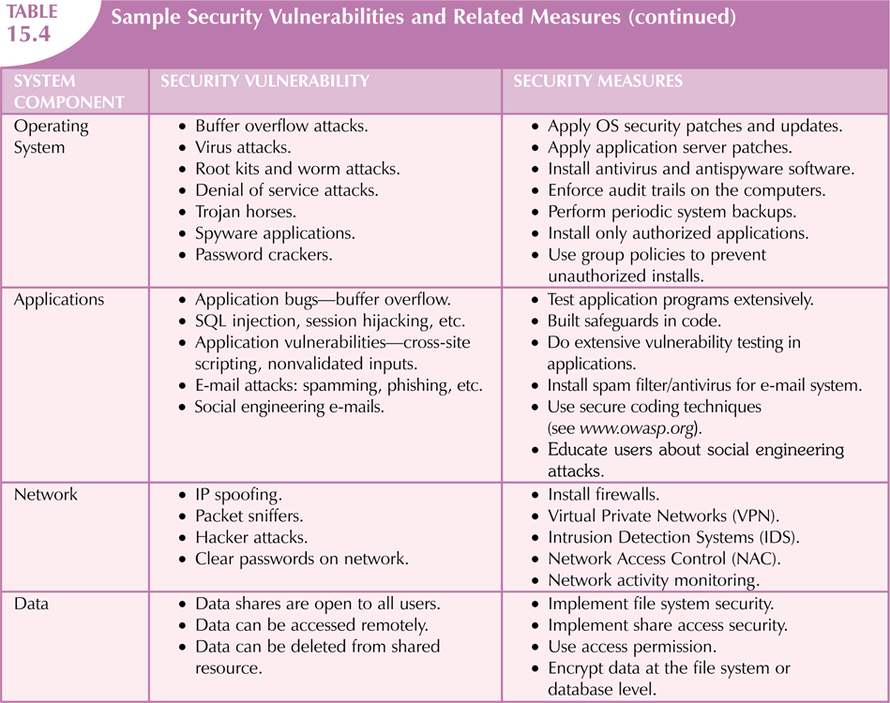
Database Systems, 9th Edition

Slide 24
Database Security
Refers to the use of DBMS features and other measures to comply with security requirements
DBA secures DBMS from installation through operation and maintenance
Authorization management:
  User access management
  View definition
  DBMS access control
  DBMS usage monitoring
Database Systems, 9th Edition

Slide 25
Database Administration Tools
Two main types of data dictionaries:
  Integrated
  Standalone
Active data dictionary is automatically updated by the DBMS with every database access
Passive data dictionary requires running a batch process
Main function: store description of all objects that interact with database
Database Systems, 9th Edition

Slide 26
Database Administration Tools (cont’d.)
Data dictionary that includes data external to DBMS becomes flexible tool
  Enables use and allocation of all of an organization’s information
Metadata is often the basis for monitoring database use
  Also for assigning access rights to users
DBA uses data dictionary to support data analysis and design
Database Systems, 9th Edition

Slide 27
CASE Tools
Computer-aided systems engineering
  Automated framework for SDLC
  Structured methodologies and powerful graphical interfaces
Front-end CASE tools provide support for planning, analysis, and design phases
Back-end CASE tools provide support for coding and implementation phases
Database Systems, 9th Edition

Slide 28
CASE Tools (cont’d.)
Typical CASE tool has five components
  Graphics for diagrams
  Screen painters and report generators
  Integrated repository
  Analysis segment
  Program documentation generator
Database Systems, 9th Edition

Slide 29
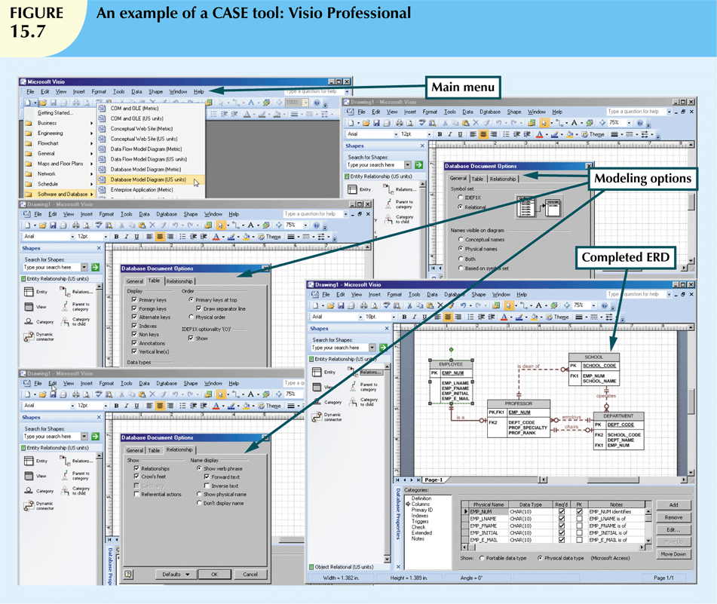
Database Systems, 9th Edition

Slide 30
Developing a Data
Administration Strategy
Information engineering (IE) translates strategic goals into data and applications
Information systems architecture (ISA) is the output of IE process
Implementing IE is a costly process
  Provides a framework that includes use of computerized, automated, and integrated tools
Success of information systems strategy depends on critical success factors
  Managerial, technological, and corporate culture
Database Systems, 9th Edition

Slide 31
The DBA at Work: Using Oracle for Database Administration
Technical tasks handled by the DBA in a specific DBMS:
  Creating and expanding database storage structures
  Managing database objects
  Managing end-user database environment
  Customizing database initialization parameters
All DBMS vendors provide programs to perform database administrative tasks
Database Systems, 9th Edition

Slide 32
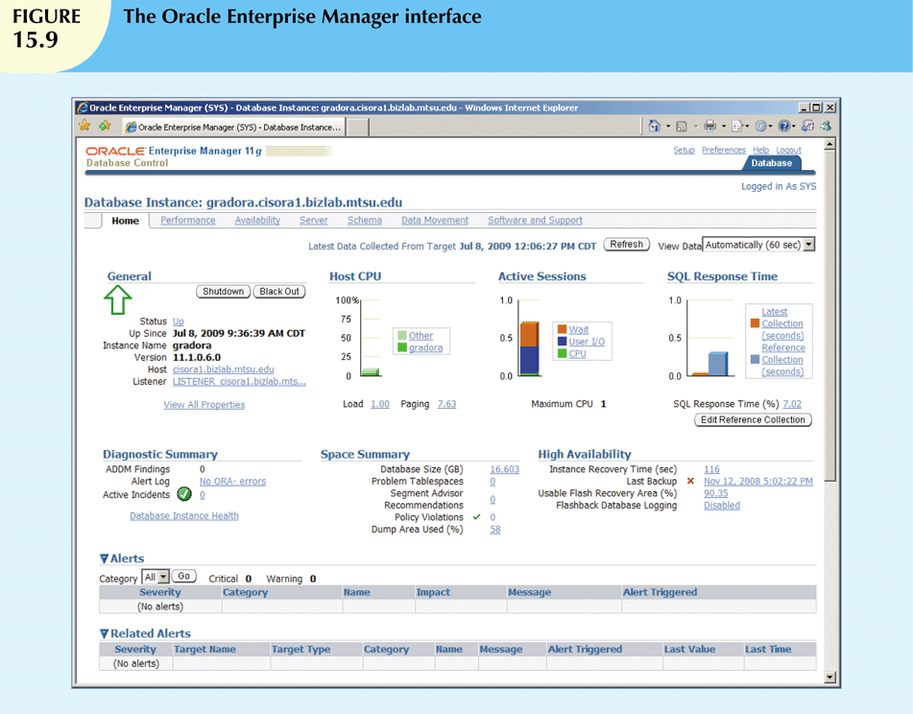
Oracle Database Administration Tools
Database Systems, 9th Edition

Slide 33
The Default Login
Must connect to the database to perform administrative tasks
  Username with administrative privileges
Oracle automatically creates SYSTEM and SYS user IDs with administrative privileges
Define preferred credentials by clicking on Preferences link, then Preferred Credentials
Username and passwords are database-specific
Database Systems, 9th Edition

Slide 34
Ensuring an Automatic RDBMS Start
DBA ensures database access is automatically started when computer turned on
A service is a Windows system name for a special program that runs automatically
  Part of the operating system
Database instance: separate location in memory reserved to run the database
  May have several databases running in memory at the same time
Database Systems, 9th Edition

Slide 35
Creating Tablespaces and Datafiles
Database composed of one or more tablespaces
Tablespace is a logical storage space
  Physically stored in one or more datafiles
Datafile physically stores the database’s data
  Each datafile can reside in a different directory on the hard disk
Database has 1:M relationship with tablespaces
Tablespace has 1:M relationship with datafiles
Database Systems, 9th Edition

Slide 36
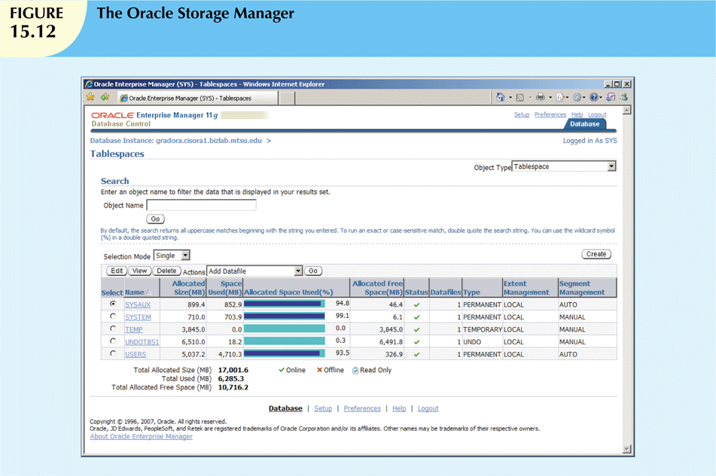
Database Systems, 9th Edition

Slide 37
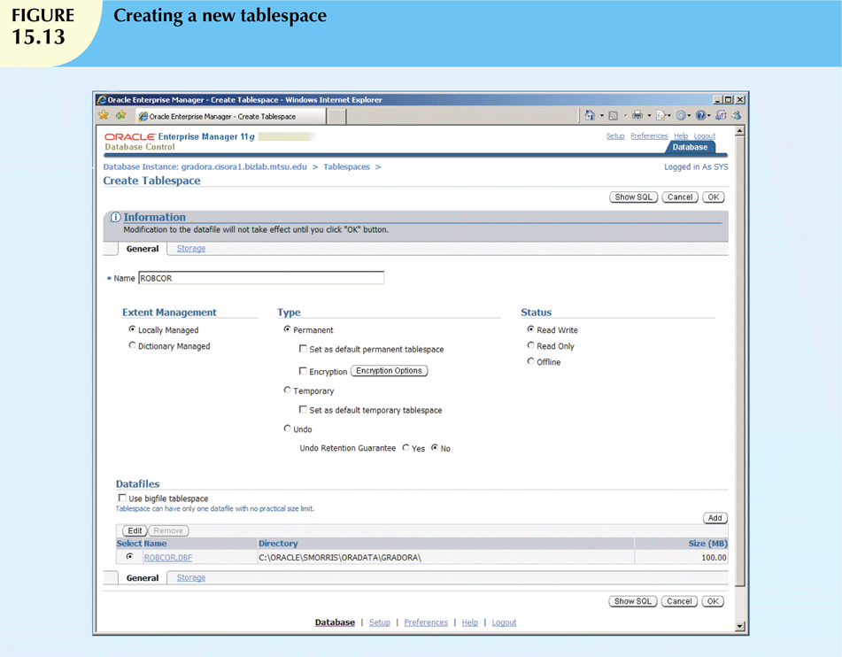
Database Systems, 9th Edition

Slide 38
Managing the Database Objects: Tables, Views, Triggers, and Procedures
Database object: any object created by end users
Schema: logical section of the database that belongs to a given user
  Schema identified by a username
  Within the schema, users create their own tables and other objects
Normally, users are authorized to access only the objects that belong to their own schemas
Database Systems, 9th Edition

Slide 39
Managing Users and
Establishing Security
User: uniquely identifiable object
  Allows a given person to log on to the database
Role: a named collection of database access privileges
  Authorizes a user to connect to the database and use system resources
Profile: named collection of settings
  Controls how much of a resource a given user can use
Database Systems, 9th Edition

Slide 40
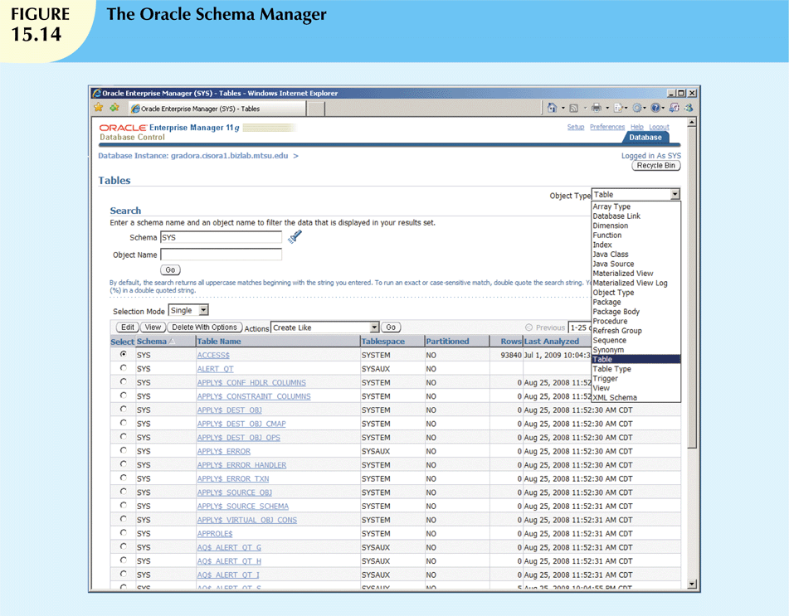
Database Systems, 9th Edition

Slide 41
Customizing the Database
Initialization Parameters
Fine-tuning requires modification of database configuration parameters
  Some are changed in real time using SQL
  Some affect database instance
  Others affect entire RDBMS and all instances
Initialization parameters reserve resources used by the database at run time
After modifying parameters, may need to restart the database
Database Systems, 9th Edition

Slide 42
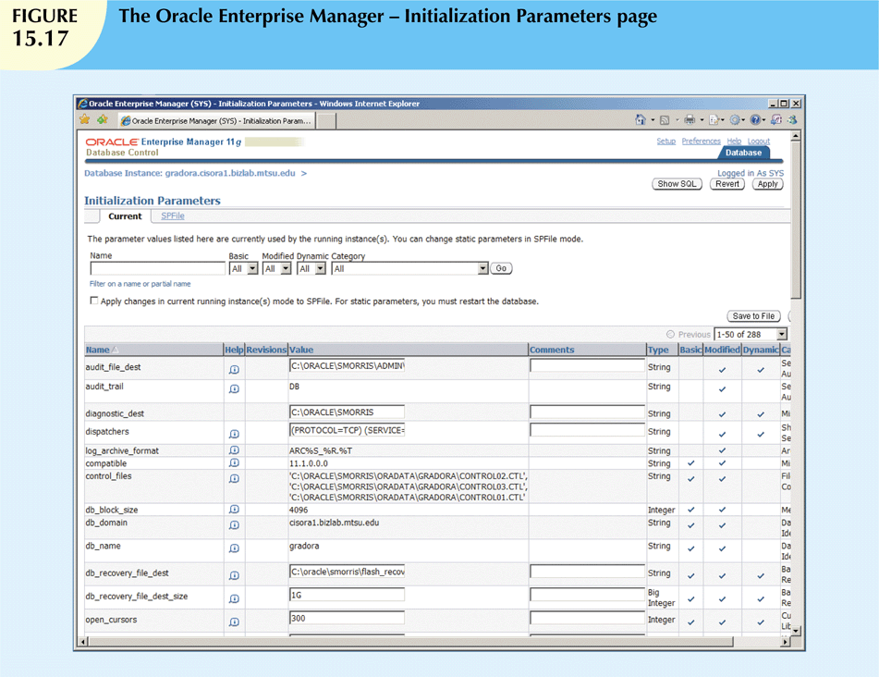
Database Systems, 9th Edition

Slide 43
Summary
Data management is a critical activity for any organization
  Data should be treated as a corporate asset
DBMS is the most commonly used electronic tool for corporate data management
DBMS has impact on organization’s managerial, technological, and cultural framework
Data administration function evolved from centralized electronic data processing
Database Systems, 9th Edition

Slide 44
Summary (cont’d.)
Database administrator (DBA) is responsible for managing corporate database
Broader data management activity is handled by data administrator (DA)
DA is more managerially oriented than more technically oriented DBA
  DA function is DBMS-independent
  DBA function is more DBMS-dependent
When there is no DA, DBA executes all DA functions
Database Systems, 9th Edition

Slide 45
Summary (cont’d.)
Managerial services of DBA function:
  Supporting end-user community
  Defining and enforcing policies, procedures, and standards for database function
  Ensuring data security, privacy, and integrity
  Providing data backup and recovery services
  Monitoring distribution and use of data in database
Database Systems, 9th Edition

Slide 46
Summary (cont’d.)
Technical role of DBA:
  Evaluating, selecting, and installing DBMS
  Designing and implementing databases and applications
  Testing and evaluating databases and applications
  Operating DBMS, utilities, and applications
  Training and supporting users
  Maintaining DBMS, utilities, and applications
Database Systems, 9th Edition

Slide 47
Summary (cont’d.)
Security: ensures confidentiality, integrity, availability of information system and data
Security policy: collection of standards, policies, and practices
Security vulnerability: weakness in system component
Information engineering guides development of data administration strategy
CASE tools and data dictionaries translate strategic plans to operational plans
Database Systems, 9th Edition

